Slide 1
Math 152 – Lesson 7
Lesson | Topic | Reading | Homework
M6 | Indefinite Integrals & Net Change Theorem | 5.4 | 49, 51
M7 | Substitution Rule | 5.5 | 3,17,33
M8 | Area Between Curves | 6.1 | 13, 29
Upcoming Suspenses
M10 | 15 Sept | FSPA 2/FS Quiz #2
M11 | 17 Sept | HW Set #2/ WW #1/ GR #1

Slide 2
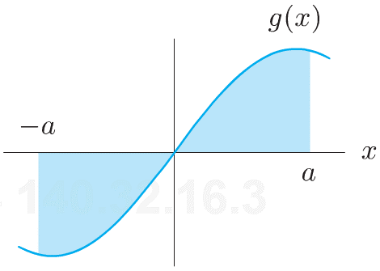
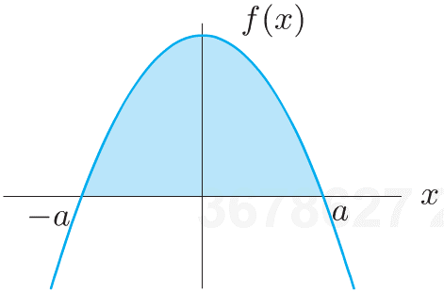
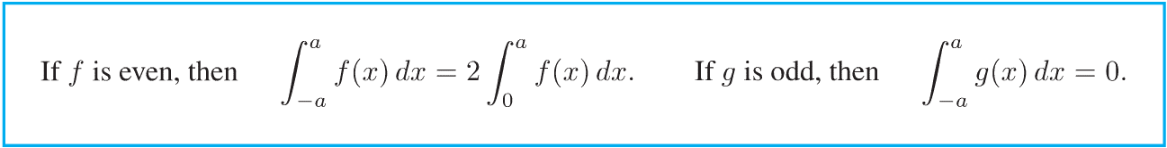
Symmetry

Slide 3
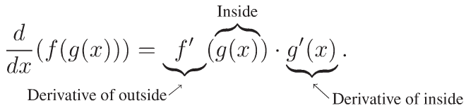
“Undoing” The Chain Rule

Slide 4
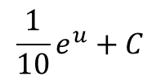
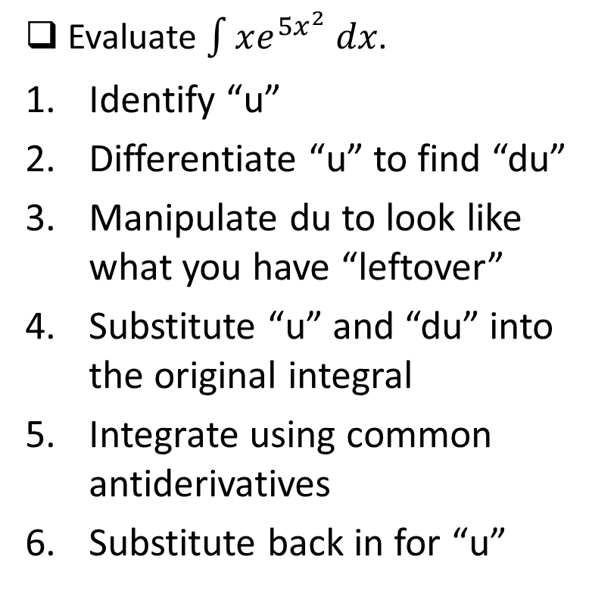
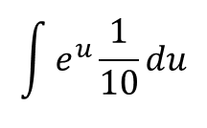
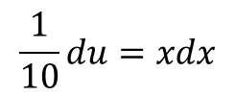


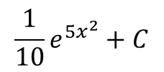
Steps to Integration by Substitution
Evaluate $\int{xe^{{5x}^{2}} dx}$.
Identify “u”
Differentiate “u” to find “du”
Manipulate du to look like what you have “leftover”
Substitute “u” and “du” into the original integral
Integrate using common antiderivatives
Substitute back in for “u”
$$u=5x^{2}$$
$$du=10x dx$$
$$\frac{1}{10}du=xdx$$
$$\int{e^{u}\frac{1}{10}du}$$
$$\frac{1}{10}e^{u}+C$$
$$\frac{1}{10}e^{5x^{2}}+C$$
Notes:
The u that choose must allow for all of the x’s to cancel out

Slide 5
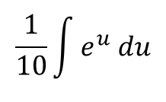
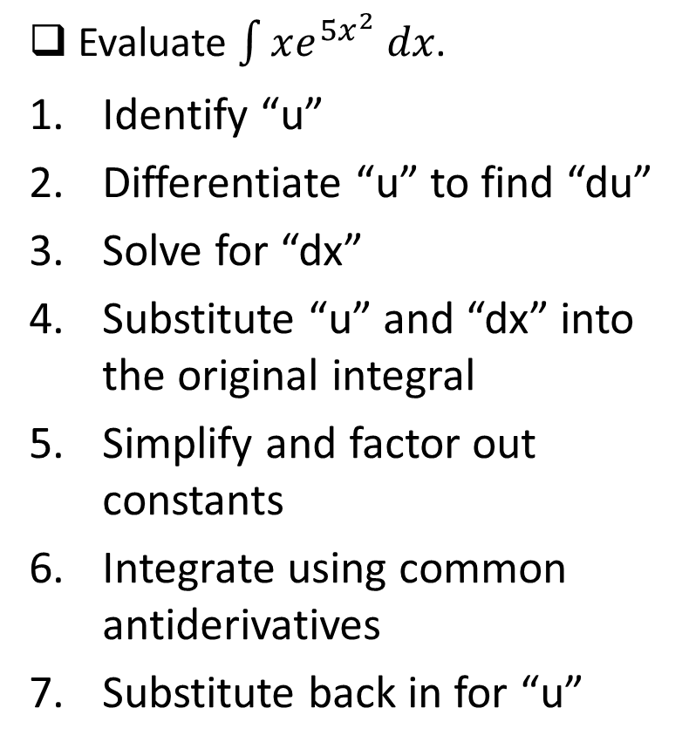
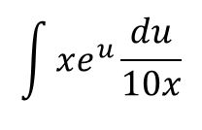
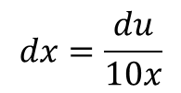

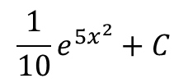
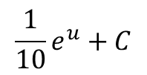
Steps to Integration by Substitution
Evaluate $\int{xe^{{5x}^{2}} dx}$.
Identify “u”
Differentiate “u” to find “du”
Solve for “dx”
Substitute “u” and “dx” into the original integral
Simplify and factor out constants
Integrate using common antiderivatives
Substitute back in for “u”
$$u=5x^{2}$$
$$du=10x dx$$
$$dx=\frac{du}{10x}$$
$$\int{xe^{u}\frac{du}{10x}}$$
$$\frac{1}{10}\int{e^{u} du}$$
$$\frac{1}{10}e^{u}+C$$
$$\frac{1}{10}e^{5x^{2}}+C$$
Notes:
The u that choose must allow for all of the x’s to cancel out

Slide 6
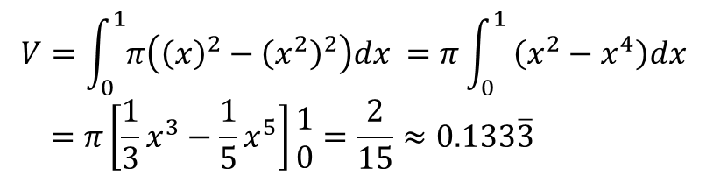

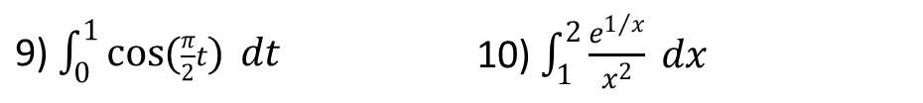
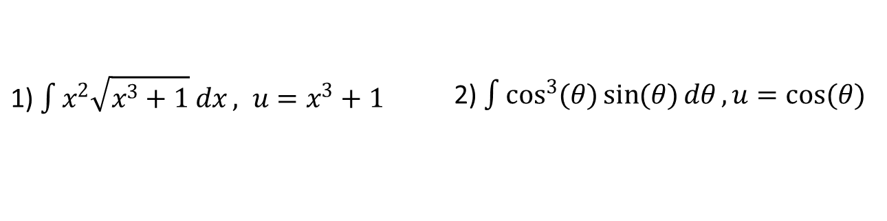
Board Work
Evaluate the integral by making the given substitution
Evaluate the indefinite integral
Evaluate the definite integral
If $f(x)$ is even, $\int_{−3}^{3}{f(x)}dx=14$, and $\int_{−5}^{5}{f(x)}dx=12$, what is $\int_{3}^{5}{f(x)}dx$?
1) $\int{x^{2}\sqrt{x^{3}+1} dx}, u=x^{3}+1$ | 2) $\int{\cos^{3}{(θ)}\sin{(θ)}dθ}, u=\cos{(θ)}$
3) $\int{x\sin{(x^{2})} dx}$ | 4) $\int{{(1−2y)}^{9} dy}$ | 5) $\int{\frac{dz}{5−3z}}$
6) $\int{t^{2}e^{t^{3}} dt}$ | 7) $\int{\frac{\sin{(\sqrt{θ})}}{\sqrt{θ}}} dθ$ | 8) $\int{\frac{e^{u}}{{(1−e^{u})}^{2}} du}$
9) $\int_{0}^{1}{\cos{(\frac{π}{2}t)} dt}$ | 10) $\int_{1}^{2}{\frac{e^{1/x}}{x^{2}} dx}$

